Slide 1

LME + blocking
R analysis

Slide 2


NLP
Sentiment analysis
HARPE
DATA
SCIENCE

Slide 3
Sample size?
R simulation

Slide 4
NLP basics
HARPE
DATA
SCIENCE

Slide 5
T-test
R Bootcamp
2.5

Slide 6
Regression
R Bootcamp
2.4

Slide 7
Correlation
R Bootcamp
2.3

Slide 8
Distributions
R Bootcamp
2.2

Slide 9
summarizing
data
R Bootcamp
2.1
HARPE
DATA
SCIENCE

Slide 10
HAP-E
Machine learning
concept
HARPE
DATA
SCIENCE

Slide 11
HAP-E
Stats basics
HARPE
DATA
SCIENCE

Slide 12
HAP-E
Data wrangling
HARPE
DATA
SCIENCE

Slide 13
HAP-E
Python graphs
HARPE
DATA
SCIENCE

Slide 14

HAP-E
Python setup
HARPE
DATA
SCIENCE

Slide 15
manipulating
data
R Bootcamp
1.5
HARPE
DATA
SCIENCE

Slide 16
R Bootcamp
1.4
HARPE
DATA
SCIENCE

Slide 17
R Bootcamp
1.3
HARPE
DATA
SCIENCE

Slide 18

Github
Website
HARPE
HARPE
DATA
SCIENCE
SCIENCE

Slide 19


R Bootcamp
0.0 overview
HARPE
HARPE
DATA
SCIENCE
SCIENCE

Slide 20

R Bootcamp
0.1 RStudio
HARPE
HARPE
DATA
SCIENCE
SCIENCE

Slide 21
R Bootcamp
1.1 R Syntax
HARPE
HARPE
DATA
SCIENCE
SCIENCE

Slide 22
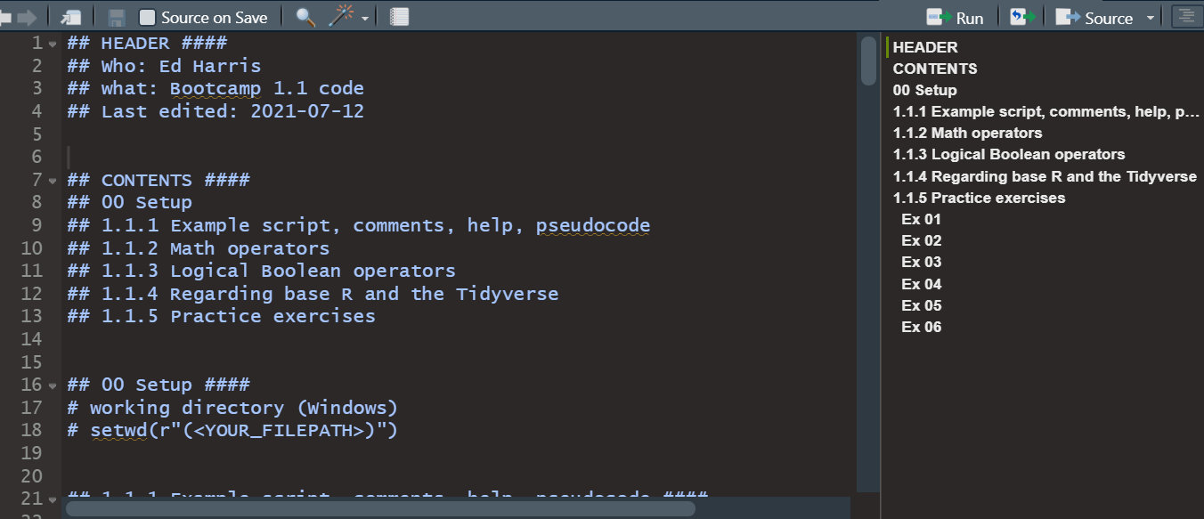
R Bootcamp
1.1 R Syntax
HARPE
HARPE
DATA
SCIENCE
SCIENCE

Slide 23
R Bootcamp
1.2 Functions
HARPE
HARPE
DATA
SCIENCE
SCIENCE

Slide 24
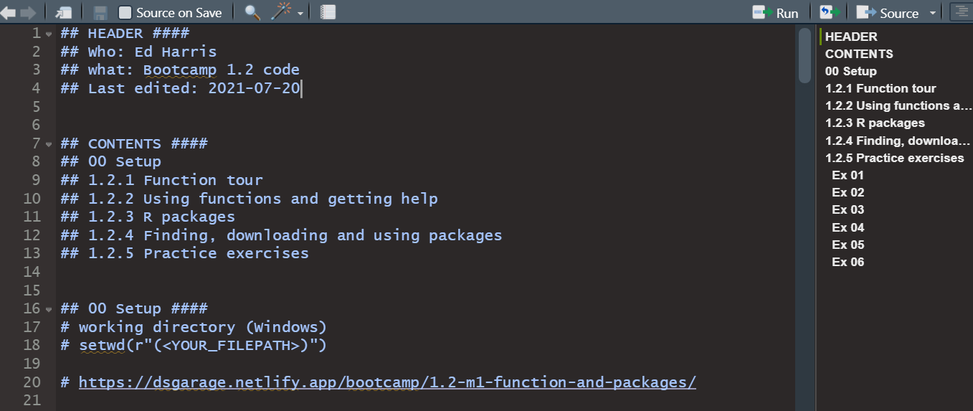
R Bootcamp
1.2 Functions
HARPE
HARPE
DATA
SCIENCE
SCIENCE

Slide 25


Q
C7081
2021
antine

Slide 26
Q
antine
Q
antine

Slide 27


HARPE
D
D
HARPE
HARPE
T
T
A
A
2021
HA UG!
D
HARPE
T
2021
A

Slide 28
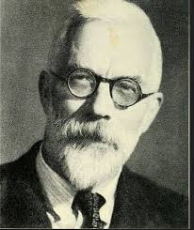

HARPE
HARPE
DATA
SCIENCE
HARPE
HARPE
DATA
SCIENCE

Slide 29


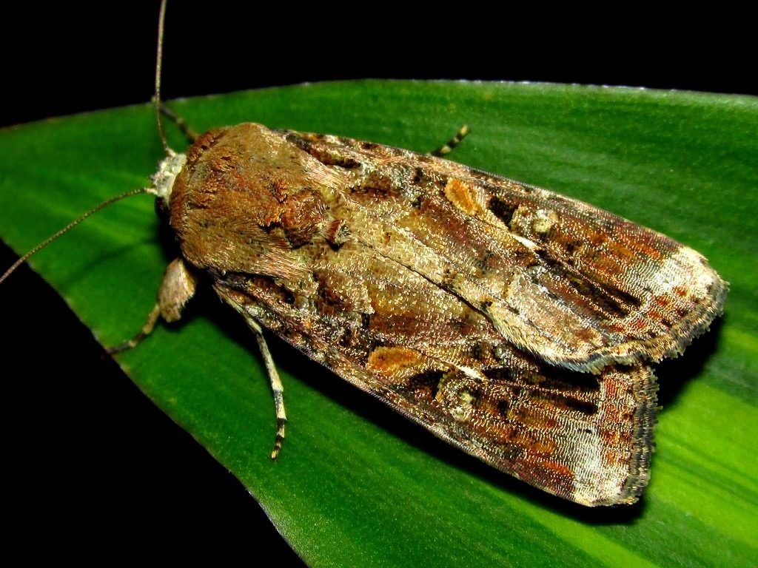























DS
EDA
2021
GA
AGE
DS
2021
DATA
SCIENCE
DS
GA
AGE

Slide 31

shinycustomloader
shinycustomloader
shinycustomloader
shinycustomloader
shinycustomloader
shinycustomloader
shinycustomloader
shinycustomloader
http://hexb.in/sticker.html

